Slide 1
Model of how healthcare works, why it matters, and how to fix it
James Trimarchi
12/8/2025

Slide 2
Flow of money in Vermont’s healthcare ecosystem
Vermonters don’t have enough money left to spend in other sectors of Vermont’s economy
Vermont’s economic vibrancy and sustainability is in jeopardy
Vermonters pay too much for healthcare

Slide 3
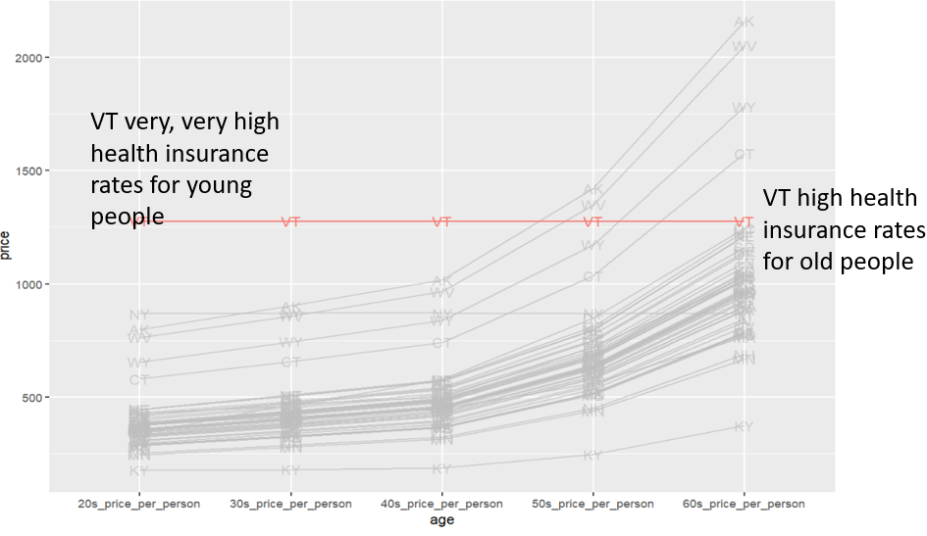
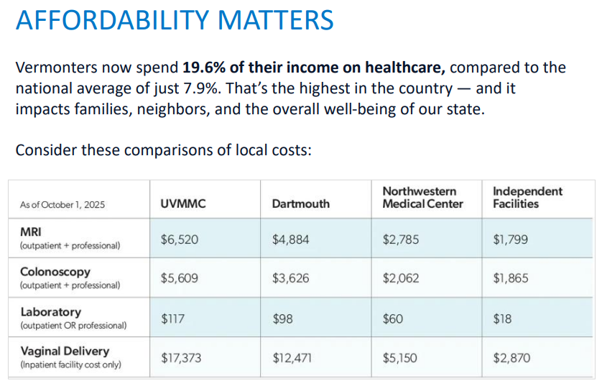
Flow of money in Vermont’s healthcare ecosystem
Pay for Premiums
Vermonters pay too much for healthcare
Pay for Care

Slide 4
Flow of money in Vermont’s healthcare ecosystem
Commercial insurance providers charge too much for insurance
Pay for premiums
Hospitals charge too much
Vermonters pay too much for healthcare
Pay for care

Slide 5
Flow of money in Vermont’s healthcare ecosystem
Commercial insurance providers charge too much for insurance
Pay for premiums
Hospital Expenses are too High
Hospitals charge too much
Vermonters pay too much for healthcare
Pay for care

Slide 6
Flow of money in Vermont’s healthcare ecosystem
Legislation working from the middle out;
Give relief to commercial insurance, reduce reimbursement to hospitals
Give relief to patients, reduce payments to hospitals
Reduce hospital revenue
Force hospitals to be more efficient
ACT 55- reduce what hospitals can charge for pharmaceuticals
Commercial insurance providers charge too much for insurance
Pay for premiums
Reduce
Hospital Expenses are too High
Hospitals charge too much
Vermonters pay too much for healthcare
Reduce
Pay for care
Less Revenue will force hospitals to reduce expenses to remain fiscally solvent

Slide 7
Flow of money in Vermont’s healthcare ecosystem
Ways to reduce hospital operating expenses
Reduce administrative expenses
Lean hospital processes- more efficient, use less resources, less expensive
Create regionalization- economies of scale, share underutilized resources
Cut duplicative services and have all the care of a service line delivered at one hospital (economies of scale)
Hospital Expenses are too High

Slide 8
Flow of money in Vermont’s healthcare ecosystem
Other ways to reduce what Vermonters pay for healthcare
Repatriate care to VT hospitals from out-of-state hospitals that typically receive higher reimbursement than do VT hospitals
Collaborative launch of new clinical service lines by multiple hospitals (SVMC and RRMC) allowing care to occur in Vermont that otherwise would be unsustainable if the service line provided care for patients in only one hospital market.
Allergy care
ENT care
ERCP
Pay for premiums
Vermonters pay too much for healthcare
Pay for care

Slide 9
Flow of money in Vermont’s healthcare ecosystem
Third way to reduce what Vermonters pay for healthcare
Reduce unnecessary acute care healthcare utilization, particularly ED and inpatient utilization or excessive care at end-of-life, for Medicare and Medicare patients
How does reduction in utilization by Medicare and Medicaid patients reduce what patients with commercial insurance pay?
Pay for premiums
Vermonters pay too much for healthcare
Pay for care

Slide 10
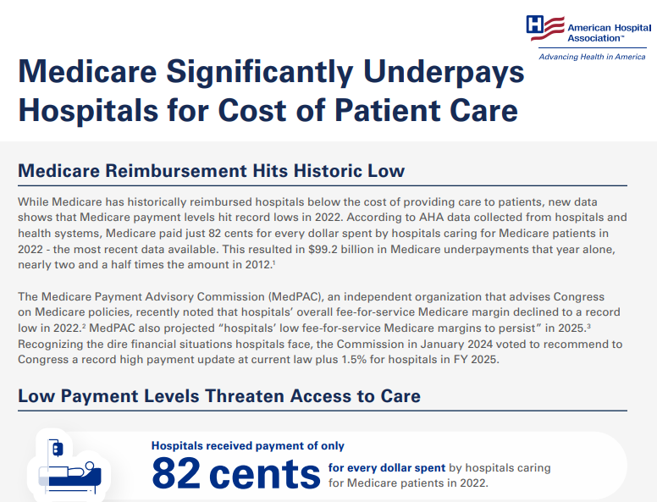
Medicare pays ~80 cents to the dollar of care received
What doctors and hospitals get paid to take care of people on Medicare has decreased, while the cost to deliver that care has increased.
Medicare's 2025 physician pay cut, explained
Far below the rate of inflation

Slide 11
How does super low Medicare payment cause super high Commercial payment?
$1,200
Expense to deliver care
$1,000
$800
Medicare Payment
Commercial Payment
Non-Vermont Hospital

Slide 12
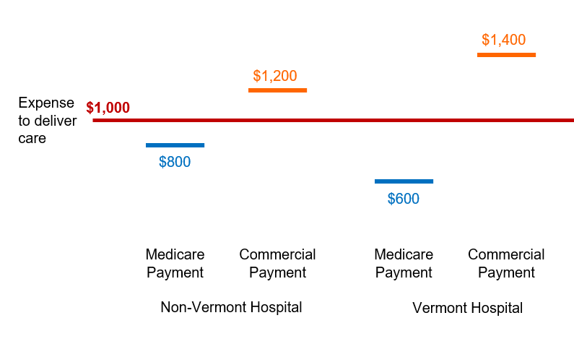
Let’s talk about VERMONT
This is called the cost shift
Old people
Young people

Slide 13
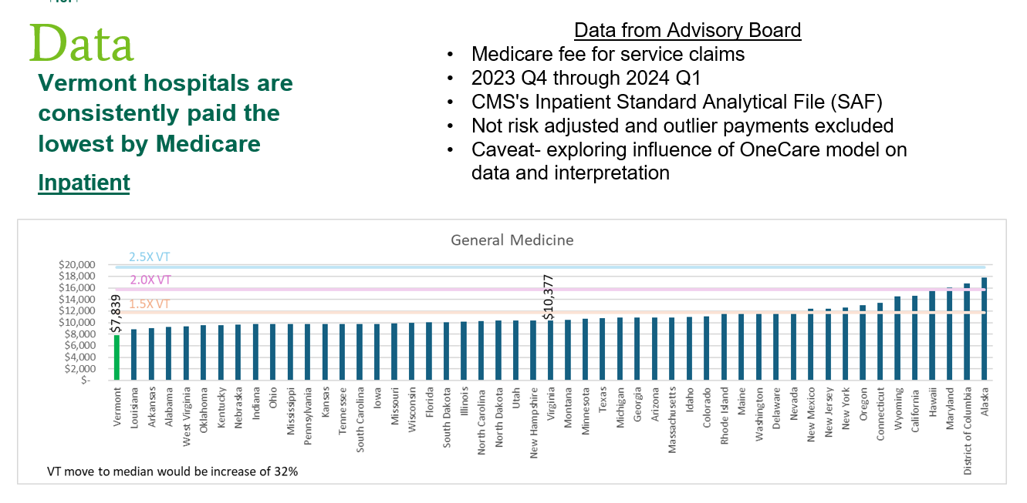
Let’s talk about VERMONT
Old people way underpay in VT!!

Slide 14
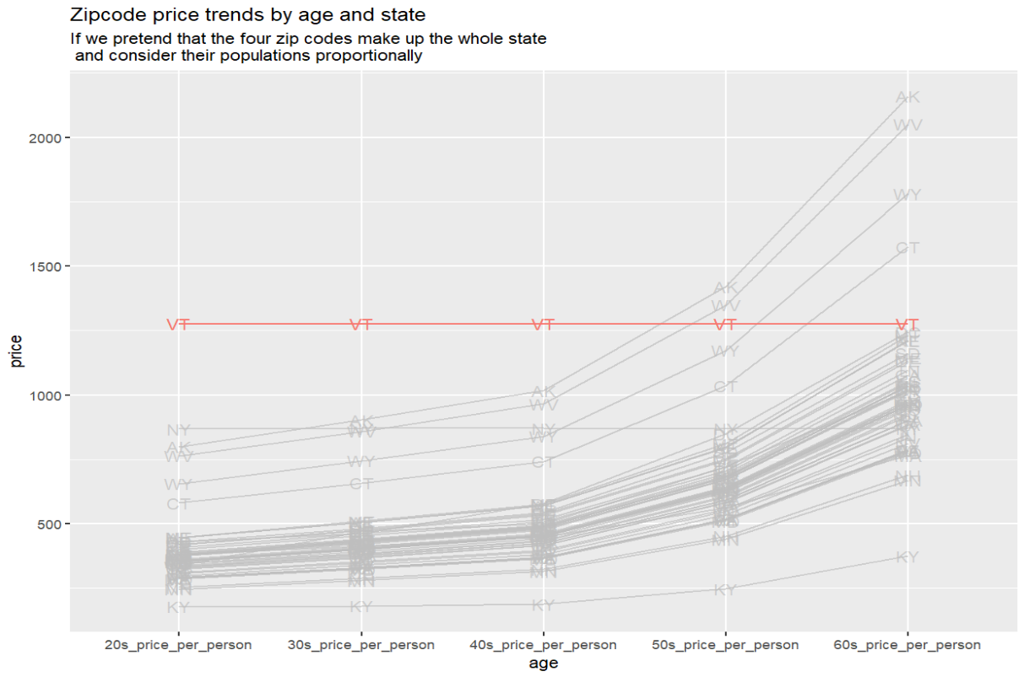
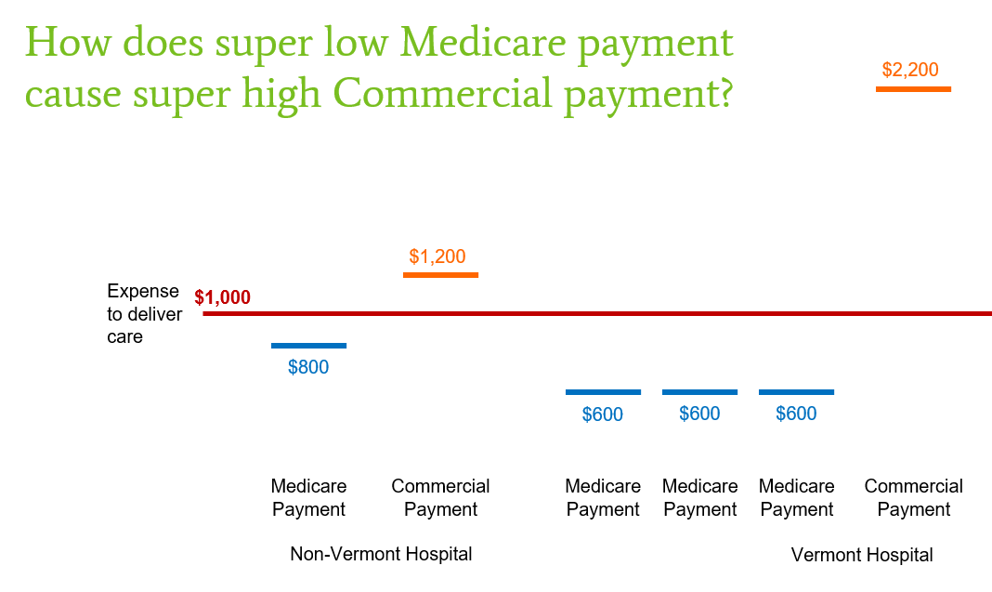
Let’s talk about VERMONT
Gotta charge young people in VT a lot!!
There’s a ton of old people in VT!!

Slide 15
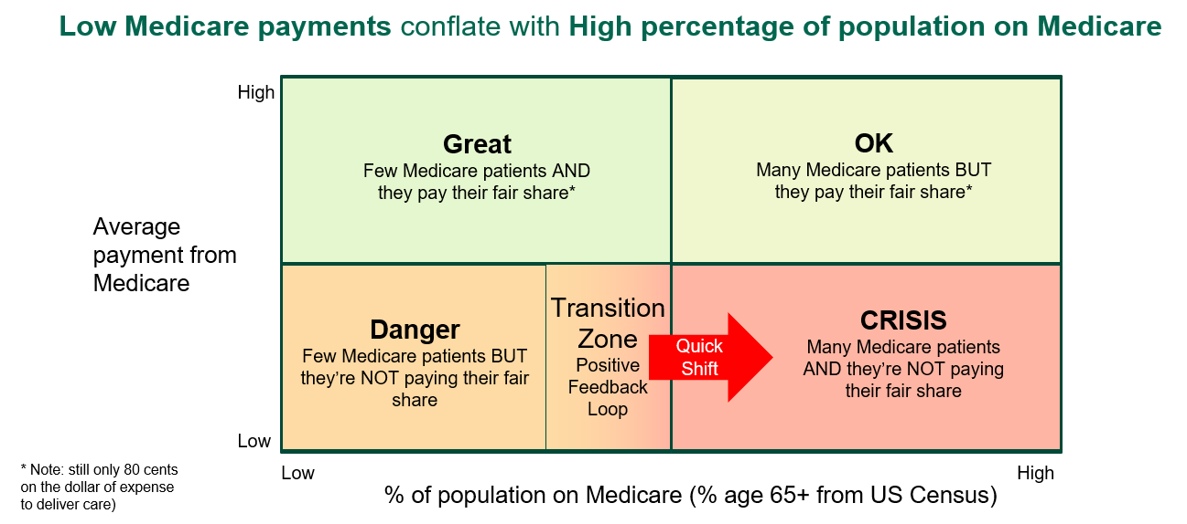
How did we get here?
Let’s talk about VERMONT

Slide 16
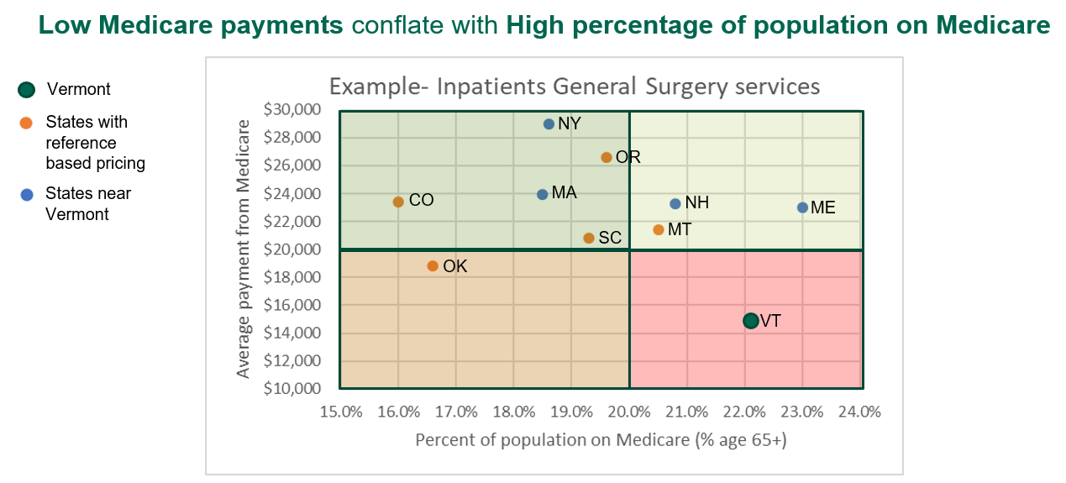
How did we get here?
Let’s talk about VERMONT

Slide 17
Flow of money in Vermont’s healthcare ecosystem
Third way to reduce what Vermonters pay for healthcare
Reduce unnecessary acute care healthcare utilization, particularly ED and inpatient utilization or excessive care at end-of-life, for Medicare and Medicare patients
A reduction in utilization by Medicare and Medicaid patients reduces the cost shift and allows a decrease in what patients with commercial insurance pay hospitals and lower insurance premiums
Pay for premiums
Vermonters pay too much for healthcare
Pay for care
This opportunity exists even if you believe that hospitals in VT are paid similar to hospitals in other states (ie 80 cents on the dollar)

Slide 18
Flow of money in Vermont’s healthcare ecosystem
How to reduce utilization by Medicare and Medicaid patients
Identify patients with abnormally high utilization
6 or more ED visits in 6 months
3 or more inpatient admissions in 6 months
Expand case management to identify root causes of high utilization for each patient
Pilot test waiving state regulations to meet these patient’s socioeconomic needs (housing, food , transportation)
Monitor results to determine if utilization declined
For Medicare patients consider interventions to reduce end-of-life utilization
Encourage advanced directives
Expand palliative and hospice care)
Launch a state-wide discussion on end-of-life care and make a concerted effort to reduce end-of-life utilization
Pay for premiums
Vermonters pay too much for healthcare
Pay for care

Slide 19
Appendix

Slide 20
Preliminary insurance data viz
Sources:
2020 Decennial Census - citywide data
KFF insurance estimator
Insurance Premiums in Vermont are abnormally high

Slide 21
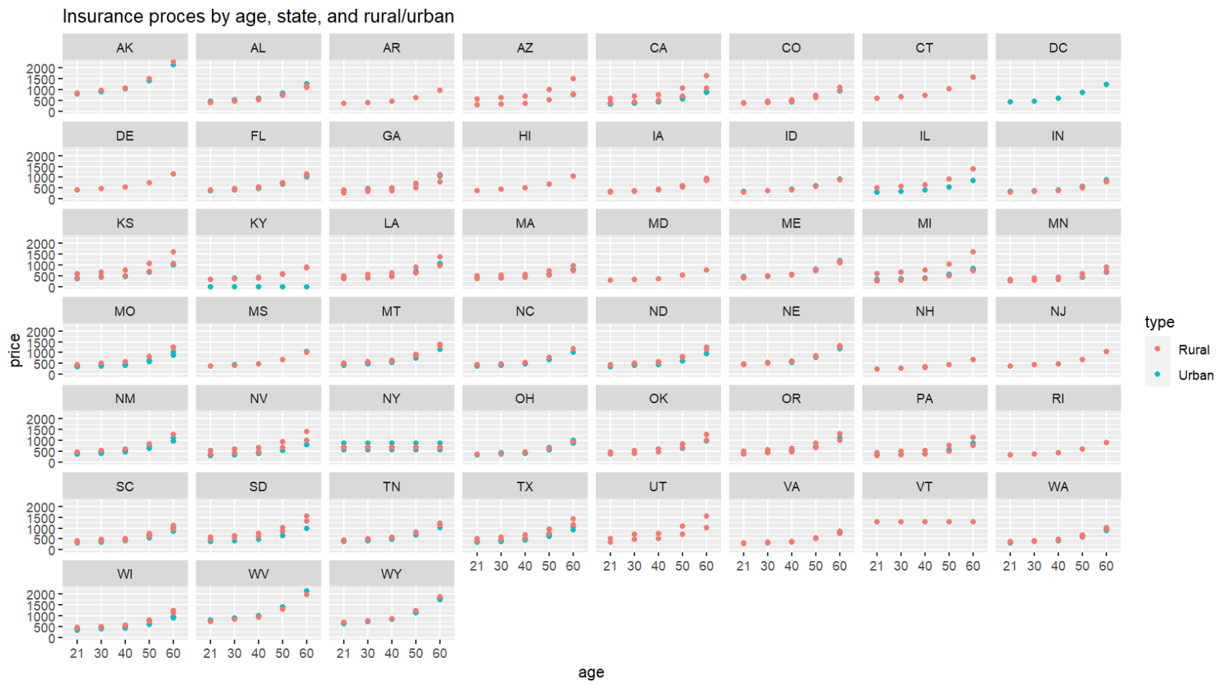
Insurance rates by age, state, and rural urban (4 zip codes per state)
VT high rates and flat across ages

Slide 22
Combine zip codes to create one curve per state
VT very, very high health insurance rates for young people
VT high health insurance rates for old people

Slide 23
Current VT insurance rates
VT
VT
What insurance rates could look like that would attract young people to VT
VT
VT
VT

Slide 24
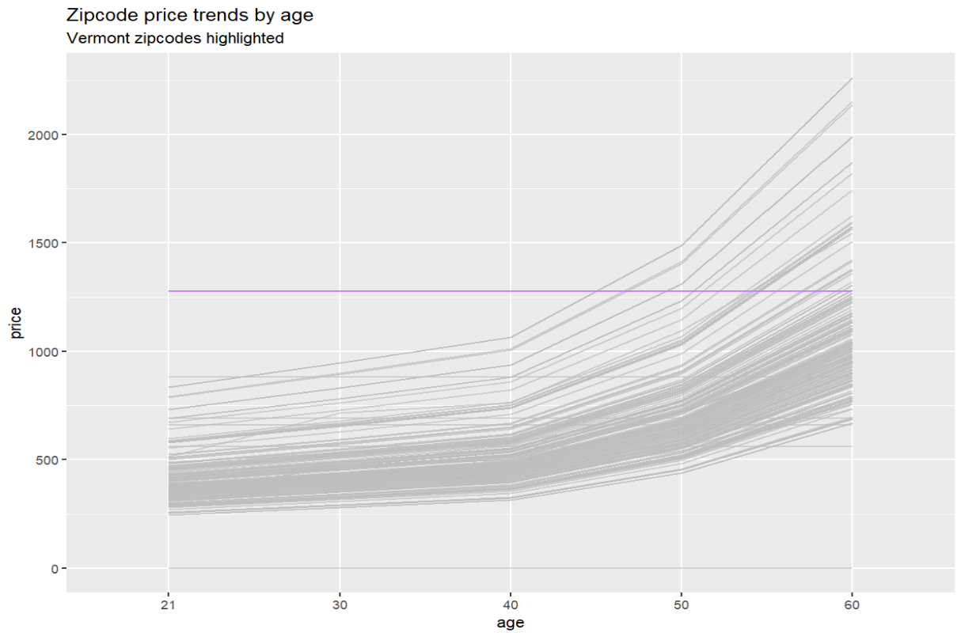
All 208 zip codes

Slide 25
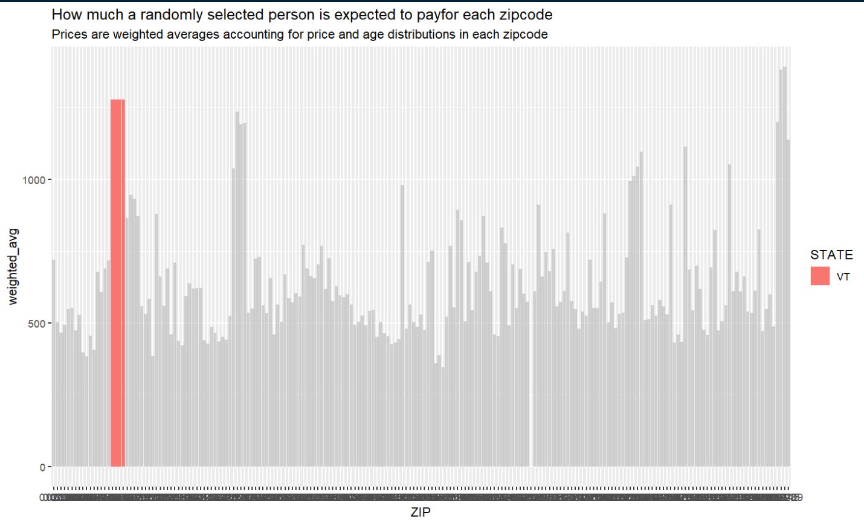
208 zip codes normalized for % of population of each age- VT health insurance still some of the most expensive in the nation
Average price, weighted by prop of age group, for each zipcode

Slide 26
Vermont population vs other states
Source: 2020 Decennial Census - Statewide data
Population demographics in Vermont are abnormal- lots of older folks, very few young folks

Slide 27
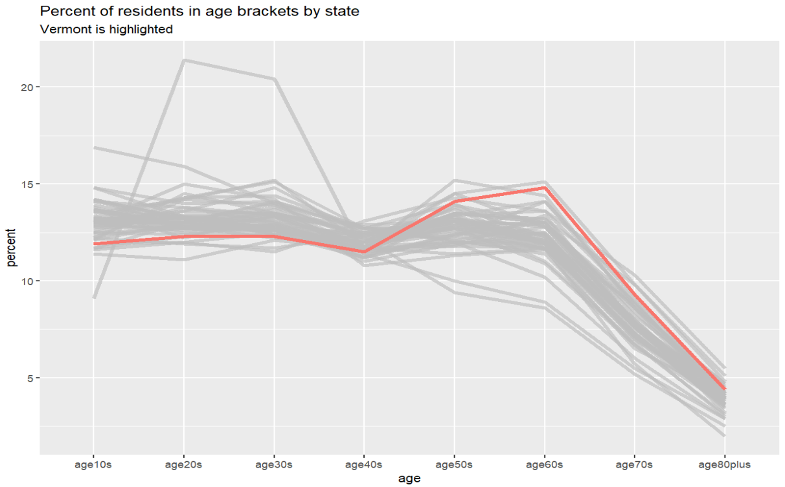

Slide 28
VT needs more young people and fewer older people

